Slide 1
ANALYSIS Project
Task sheet
CONTACT
Data ANALYSIS
DATA
COVID-19: Focused Analysis for India

Slide 2
Task sheet of project
Task sheet
CONTACT
Data ANALYSIS
What are the total number of Confirmed cases in different nations?
What are the total number of Recovered cases in different nations?
What are the total number of Confirmed cases in India?
What are the total number of Recovered cases in India?
Can we Forecast Trend-Line for COVID - 19?
Can we Group Indian States and find COVID - 19 Hits?
Find the Highest Death rates in International Level.
Find the Least Death rates in International Level.
Can we find the variation in COVID - 19 Cases around the World?
Can we predict future trends and reference data for the presence of COVID-19?

Slide 3
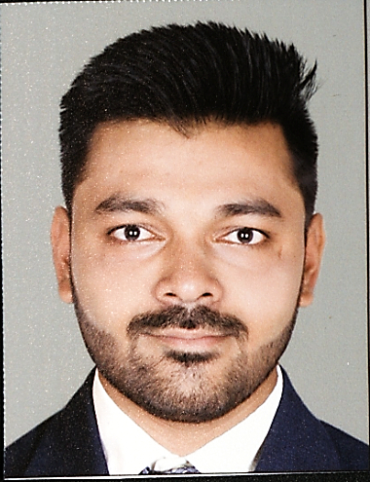
Achyutkumar golakiya
Task sheet
CONTACT
Data ANALYSIS
"Linkedin Profile"

